Slide 1
A person went to ATM to withdraw money say 5000 rs

Slide 2
A person went to ATM to withdraw money say 5000 rs
Inserted the atm card, pin entered correctly, chosen withdraw of 5000

Slide 3
A person went to ATM to withdraw money say 5000 rs
Inserted the ATM card, pin entered correctly, chosen withdraw of 5000,
ATM counts and at the time release the ATM went off

Slide 4
A person went to ATM to withdraw money say 5000 rs
Inserted the ATM card, pin entered correctly, chosen withdraw of 5000,
ATM counts and at the time release the ATM went off
Person received a message to phone successfully 5000 debited from your account

Slide 6
Withdraw money from an account
Record a sale
Pay an insurance premium
Purchase 100 shares of stock
Register an automobile
Place an order using an on-line catalog
Connect a telephone call
Track a shipment

Slide 7
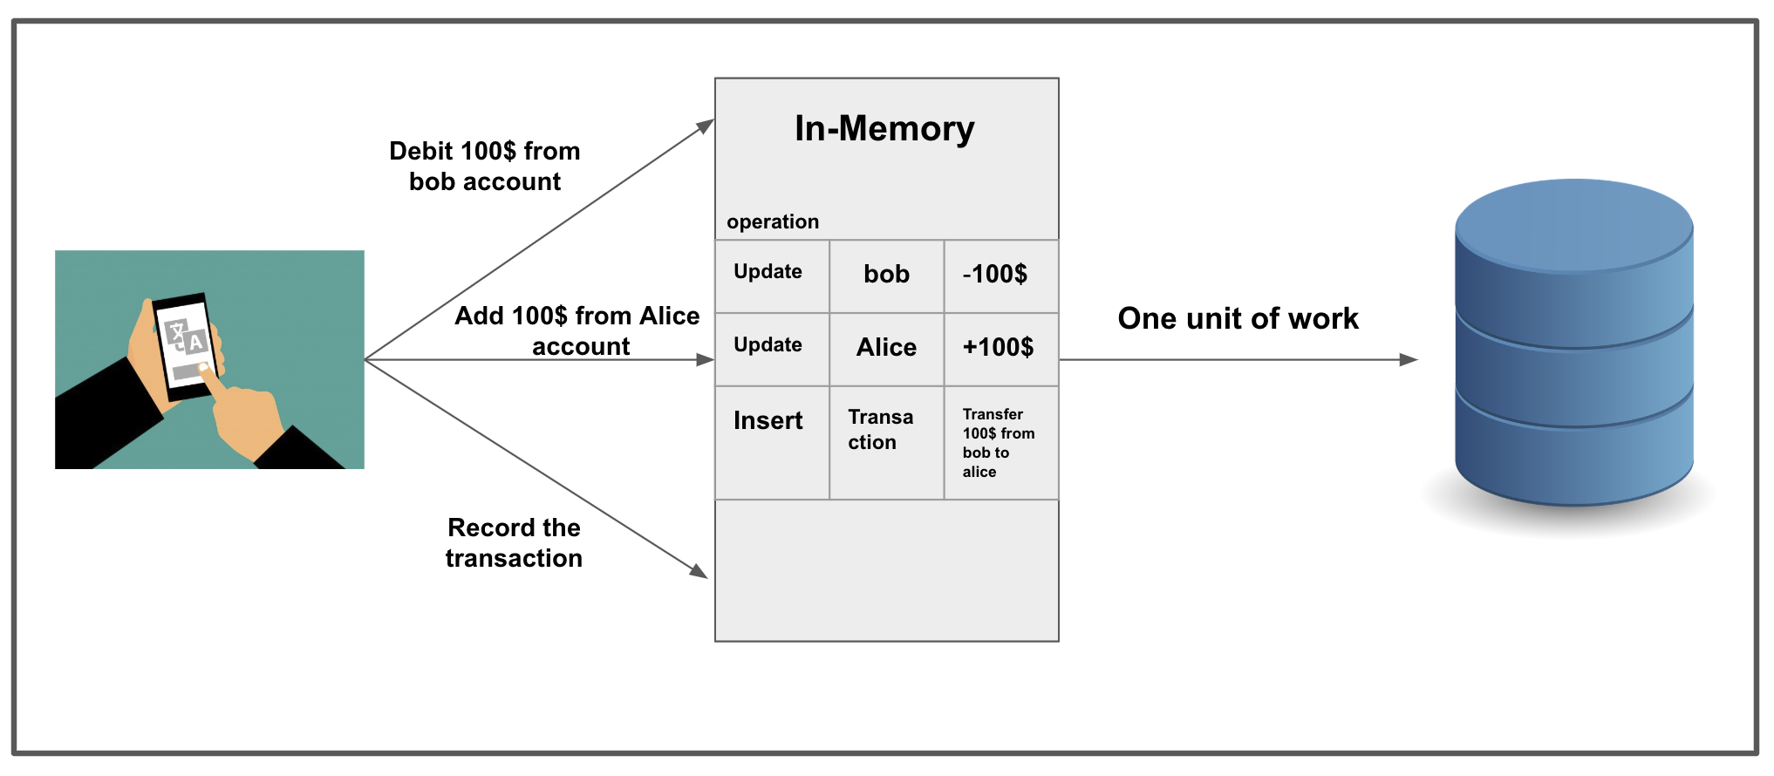

Slide 8
Application | Example Transaction
Banking | Withdraw money from an account
Securities trading | Purchase 100 shares of stock
Insurance | Pay an insurance premium
Inventory control | Record the fulfillment of an order
Manufacturing | Log a step of an assembly process
Retail point-of-sale | Record a sale
Government | Register an automobile
Online shopping | Place an order using an on-line catalog
Transportation | Track a shipment
Telecommunications | Connect a telephone call
Military Command and Control | Fire a missile
Media | Grant permission to download a video

Slide 9
Transactions

Slide 10
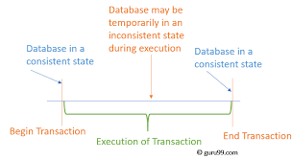

Slide 11
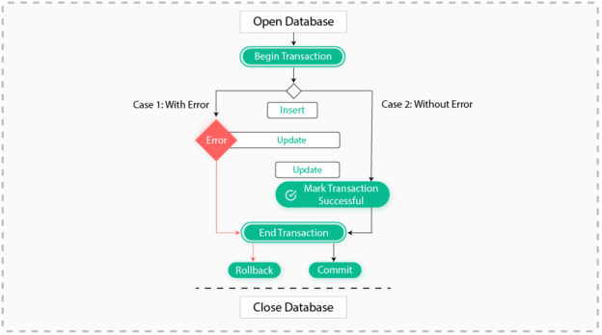

Slide 12
three records should succeed or all of them should fail

Slide 13
Unit -5
Introduction – properties, state, serialization
Concurrency system – techniques (2) – lock based protocol, timestamp based protocol (19)
Recovery System – Techniques (2), log based recovery, shadow paging (20)

Slide 14
      T1
      read(A)
      A := A – 50
      write(A)
      read(B)
      B := B + 50
      write(B)
Transfer 50 from account A to B

Slide 15
Transaction
A transaction is a unit of program execution that accesses and updates various data items.
E.g.
Transaction to transfer 50 from account A to account B
      read(A)
      A := A – 50
      write(A)
      read(B)
      B := B + 50
      write(B)

Slide 16
Properties of Transactions: ACID
Atomicity
  All or Nothing
Consistency
  No violation of integrity constants, i.e., from one consistent state to another consistent state
Isolation
  Concurrent changes invisible, i.e. serializable
Durability
  Committed updates persist (saved in permanent storage)

Slide 17
Example of Fund Transfer
Transaction to transfer 50 from account A to account B:
  1. read(A)
  2. A := A – 50
  3. write(A)
  4. read(B)
  5. B := B + 50
  6. write(B)
Atomicity requirement
  Fails after step 3 and before step 6, money will be “lost” leading to an inconsistent database state
  Partially executed transaction are not reflected in the database

Slide 18
Transaction State

Slide 19
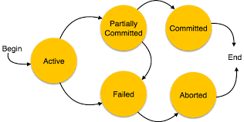

Slide 20
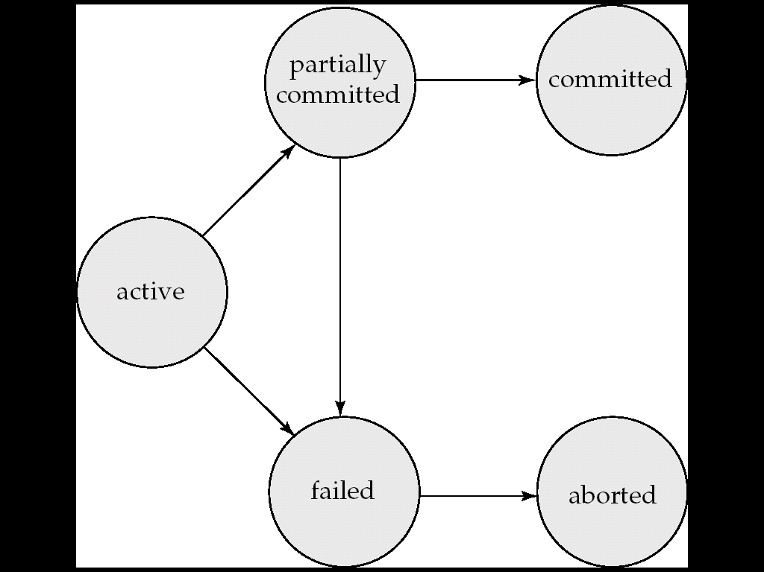
Final Statement Executed
Successful
Initial State
Kill
No Longer Execution

Slide 21
Transaction State
Active – the initial state, it is executing
Partially committed – after the final statement has been executed.
Failed -- after the discovery that normal execution can no longer proceed.
Aborted – after the transaction has been rolled back and the database restored to its state prior to the start of the transaction. Two options after it has been aborted:
  restart the transaction
    can be done only if no internal logical error
  kill the transaction
Committed – after successful completion.

